Slide 1
A Contrastive Learning Approach to Bug Severity Classification with Large Language Model Embeddings
CSCI 6100G Final Project
Presented by: Mosarrat Rumman
Anushka Zaman Emon Roy

Slide 2
Introduction
What is Bug Severity Report?
The Level of Impact of Bugs or Errors
Assesses the impact of a bug on software functionality, performance, or user experience
Helps developers prioritize fixes based on the bug's criticality

Slide 3
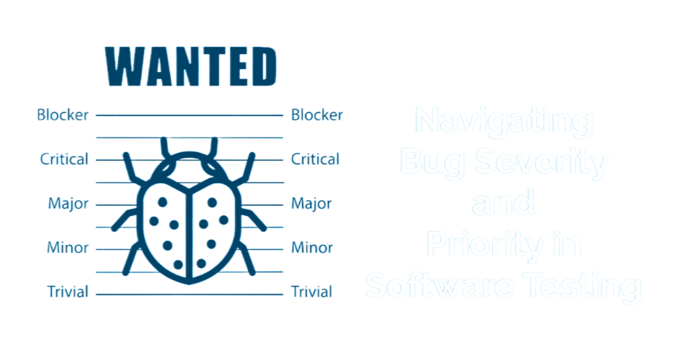
Severity Levels (Commonly Used)
Fig 1: Bug severity levels [1]

Slide 4
Related work
Using traditional machine learning methods like Naive Bayes Multinomial, K-Nearest Neighbor algorithm to create dictionary of critical term specifying bug severity. [2]
Using CNN-LSTM model combined with topic-based feature selection,achieving F-measures of 90.62% and 93.22% on Mozilla data, outperforming baseline models like DeepSeverity and EWD-Multinomial on Eclipse and Mozilla projects. [3]
Using word embedding based model like Word2Vec, GloVe which provide single vector representations per word, whereas ELMo and BERT adapt embeddings based on word context, aiding complex language tasks. [4]

Slide 5
Improvements of existing approaches
LLM embeddings
Contextual Understanding
Transfer Learning
High-Dimensional Representation
Contrastive learning
Model learns to distinguish between similar and dissimilar examples by comparing pairs of data.
Improved Generalization
Efficient Learning with Limited Labels.

Slide 6
Main contribution
Contrastive Learning-Based Fine-Tuning: that enhances semantic representation and generalization to to unseen, diverse, and imbalanced datasets.
Comprehensive Experiments: Provided a detailed comparison of the proposed model with baseline approaches across diverse datasets.
Robust Cross-Project Performance: Demonstrated the ability of the proposed model to generalize effectively across unseen projects.
Insights on Data Characteristics: Analyzed how dataset size and class imbalance impact model performance.
Practical Solution for Industry: Delivered a scalable, efficient model for automated bug severity classification in real-world software projects.

Slide 7
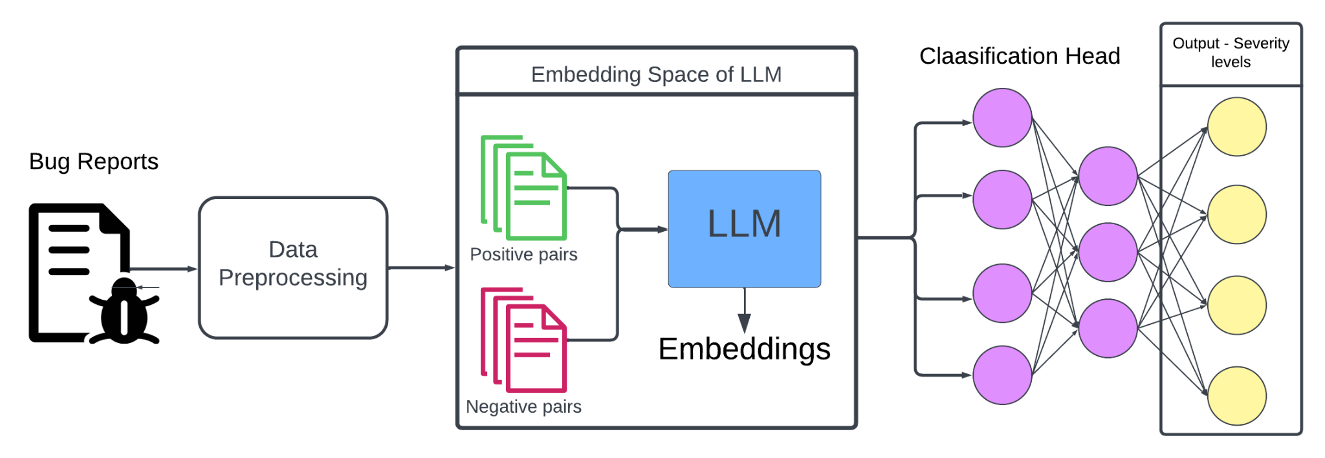
Contrastive learning
Generates embeddings in pairs
A contrastive loss is used to calculate cosine similarity of two embeddings
Trains and updates weight through backpropagation and optimization
A linear dense layer
A single bug report description is fed
Predict severity level
Data cleansing
Tokenization
Positive and negative pairs
Fig 2: Overview of proposed approach

Slide 8
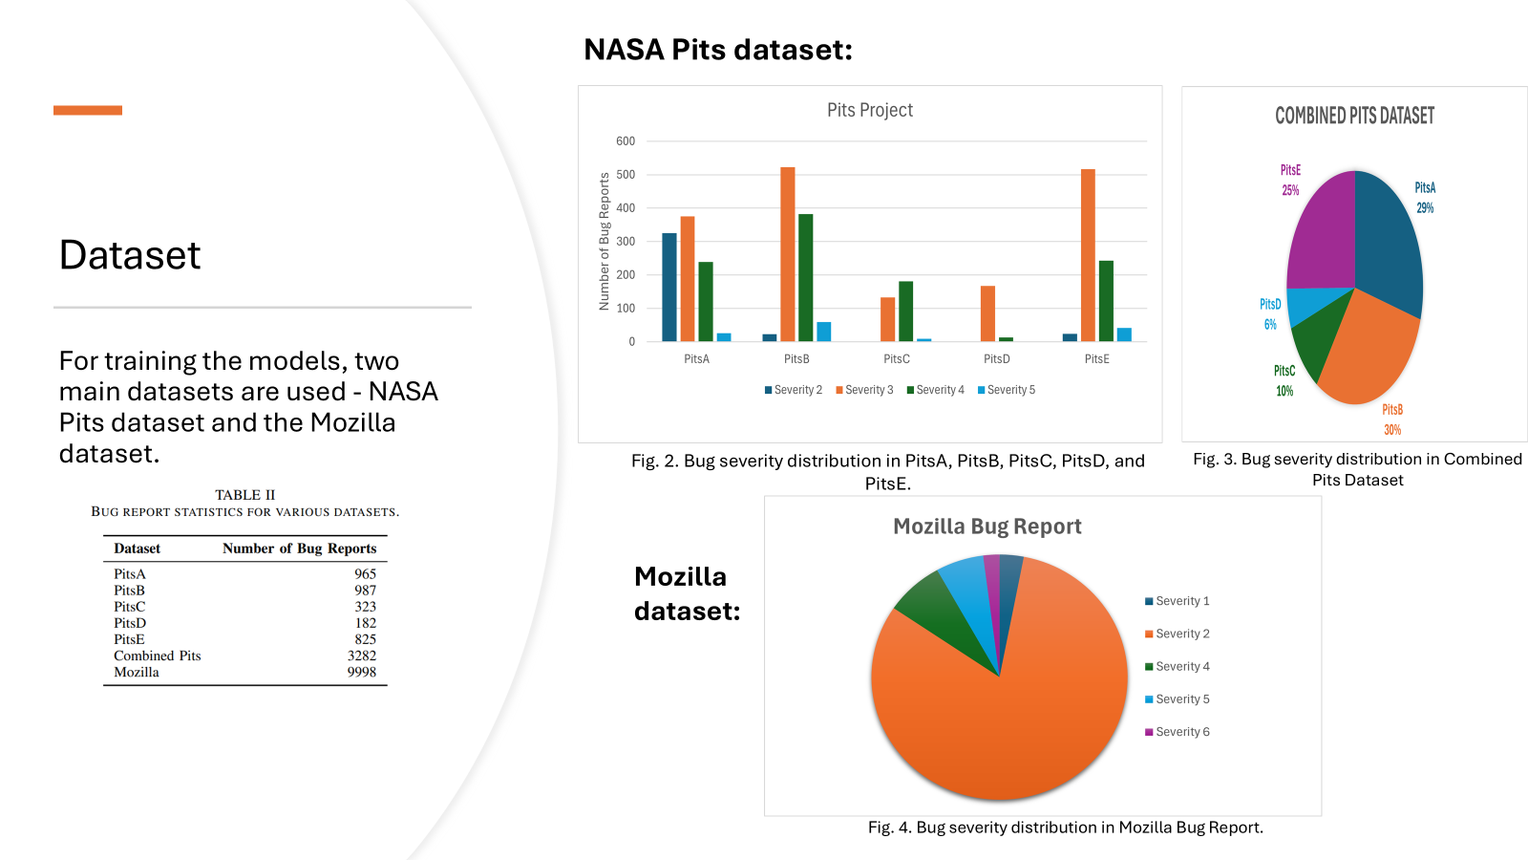
Dataset

Slide 9
Model Architecture details
Component | Details
Backbone | CodeBERT (Roberta-based pre-trained model)
Input Length | 256 tokens
Embedding Dimension | 768
Contrastive Learning | NT-Xent Loss, Temperature=0.5
Classification Head | Fully connected layer (768 → num classes)
Loss Function | Cross-Entropy Loss
Optimizer | Adam (Learning Rate = 2e-5)

Slide 10
Experiment
Research Questions:
RQ1: How effective is the proposed model in classifying bug severity within the same project in terms of accuracy,precision, and recall?
RQ2: How does the proposed model’s performance vary when trained on one or more project and tested on a completely different project, i,e., cross project performance?
RQ3: How does training with contrastive learning improve bug severity classification compared to non-contrastive approach?
RQ4: How well do Large Language Models classify bug severity across applications compared to traditional word embedding methods like Doc2Vec

Slide 11
Experiment 1: Train and Test on the Same Project
Individual Pits (A, B, C, D & E), Combined Pits and Mozilla datasets are split into 80% training and 20% test data. Addresses RQ1.
Experiment 2: Train on One or More Projects and Test on an Unseen Project
The models are trained on various combinations of Pits datasets and tested on a different, unseen Pits project. Goal is to evaluate the generalizability of the models. Addresses RQ2.
Experiment 3: Contrastive Learning vs. Non-Contrastive Learning
CodeBERT is fine tuned with Contrastive learning and without contrastive learning and the performance of these models are tested on Experiment 1 and 2 settings. Addresses RQ3.
Experiment 4: LLMs vs. Traditional Embedding Methods
Baseline research Doc2vec+MLP [5] is recreated and the performance is compared with funed tune LLMs in Experiment 1 and 2 settings. Doc2vec+MLP is trained on bug summaries and bug report description separately for fair evaluation. Addresses RQ4.

Slide 12
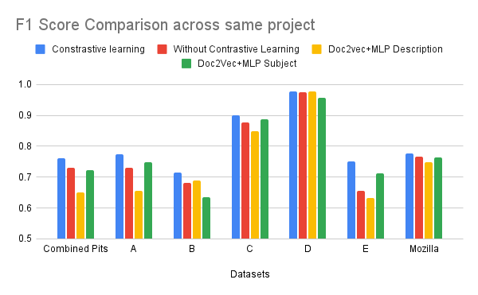
Results
Results from Experiment 1, 3, and 4.
LLm trained with Contrastive Learning outperforms other models in all datasets.
Traditional methods like Doc2Vec performed better when trained on summaries.
For simpler datasets like Pits D, all methods performed similarly, highlighting minimal dataset complexity.
Figure 5: Performance comparison of different models on same project

Slide 13
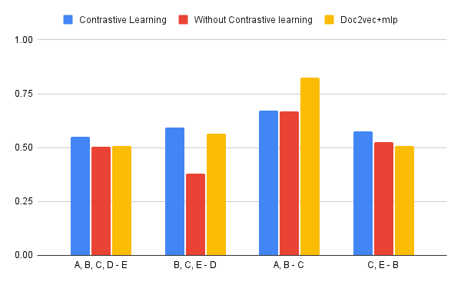
F1 score comparison on Unseen projects
Results from Experiment 2, 3 and 4.
LLM fined-tuned with contrastive learning outperforms other models in most cases.
On challenging datasets like testing on (B, C, E - D) The dataset is highly imbalance and diverse. Contrastive Learning demonstrates robustness, outperforming both non-contrastive learning and Doc2Vec.
Doc2Vec achieves the highest F1-Score (0.8249) for smaller datasets like Pits (A,B-C), leveraging structured summaries effectively.
Figure 6: Performance comparison of different models on unseen projects

Slide 14
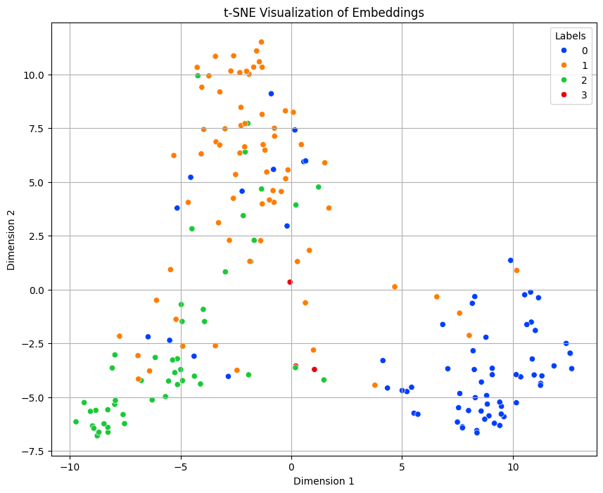
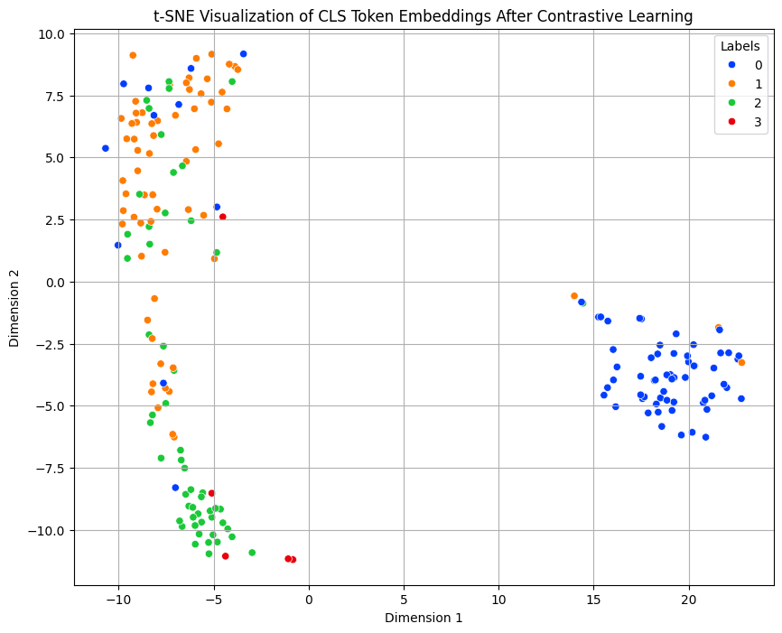
Explainability of the proposed model
Fig 7: LLM Embedding visualization without contrastive learning
Fig 8: LLM Embedding visualization with contrastive learning

Slide 15
Discussion
Contrastive Learning performs better on larger, richer and more diverse datasets.
LLMs (e.g., CodeBERT) outperform Doc2Vec on diverse datasets with unstructured descriptions.
Doc2Vec performs well on smaller datasets or structured summaries, requiring less computational power but struggles with long descriptions (accuracy < 0.50 in cross-project evaluations).
Limitations:
Class Imbalance in dataset - Models could benefit from a balanced dataset.
Computational cost - LLMs require huge computational resources compared to traditional embedding models.
Pre-Trained Model Dependency: Dependence on Code-BERT embeddings may fail to capture domain-specific nuances in bug reports.

Slide 16
Future work
Evaluate lightweight models like TinyBERT and MobileBERT for bug classification which as cost effective.
Expand testing on more diverse datasets to assess scalability and robustness.

Slide 17
References
Baciu, I. (2024, April 25). Navigating bug severity and priority in software testing. Infobest Software Outsourcing Company. Retrieved from https://www.infobest.ro/navigating-bug-severity-and-priority-in-software-testing/?fbclid=IwY2xjawGMgc9leHRuA2FlbQIxMAABHcbI_39Os4JBq3SBOxDaf54zZN0_Ms7gEy39KFs6t-HcaTnu1L8_9ip7_Q_aem_cpnZjxlTbIfxGVBxasIg_g.
Sharma, G., Sharma, S., & Gujral, S. (2015, November 21). A novel way of assessing software bug severity using dictionary of critical terms. Procedia Computer Science. Retrieved from https://www.sciencedirect.com/science/article/pii/S1877050915032238.
Kim, J., & Yang, G. (n.d.). Bug Severity Prediction Algorithm Using Topic-Based Feature Selection and CNN-LSTM Algorithm. Retrieved from https://www.iitrpr.ac.in/library/pdf/IEEE.pdf .
Chen, B., Zou, W., Cai, B., Meng, Q., Liu, W., Li, P., & Chen, L. (2024, July 25). An empirical study on the potential of word embedding techniques in bug report management tasks - empirical software engineering. Retrieved from. https://link.springer.com/article/10.1007/s10664-024-10510-3.
Arokiam, J., & Bradbury, J. S. (2020, June). Automatically predicting bug severity early in the development process. In Proceedings of the ACM/IEEE 42nd International Conference on Software Engineering: New Ideas and Emerging Results (pp. 17-20).

Slide 18
Thank You!

